Slide 1
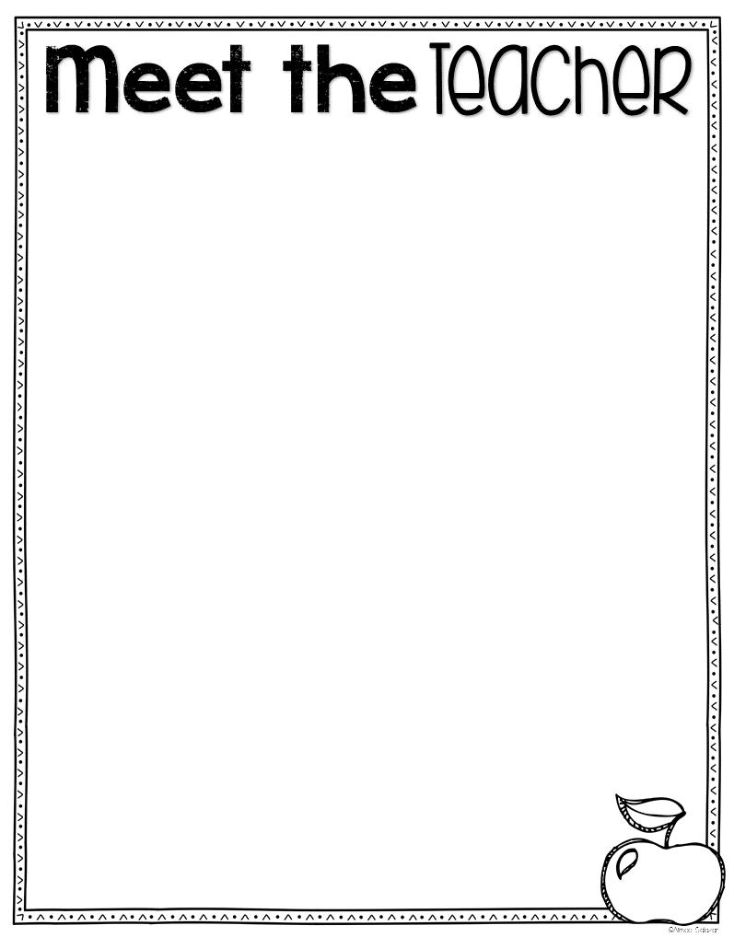
Dear Students and Families,
I am so happy to be your teacher this year! It’s going to be a fun year filled with learning and new experiences. I am really looking forward to getting to know you this year, and I just know we will have a blast learning and working together!
Before I get to know you, I would love for you to know a little bit about me. I grew up on a ranch in Texas.
I obtained my Master in Education from Northern Arizona University –GO Jacks!
I am married with four children who all attend district schools. My favorite color is pink and green. My favorite food is chocolate. ☺ My favorite place is cheering my family on in different sporting events: racing, volleyball, dance, football, soccer and baseball. My favorite hobby is to read.
I am looking forward to getting to know you. I hope you’re ready to learn, and have some fun!
Sincerely,
Mrs. Cotherman

