Slide 1
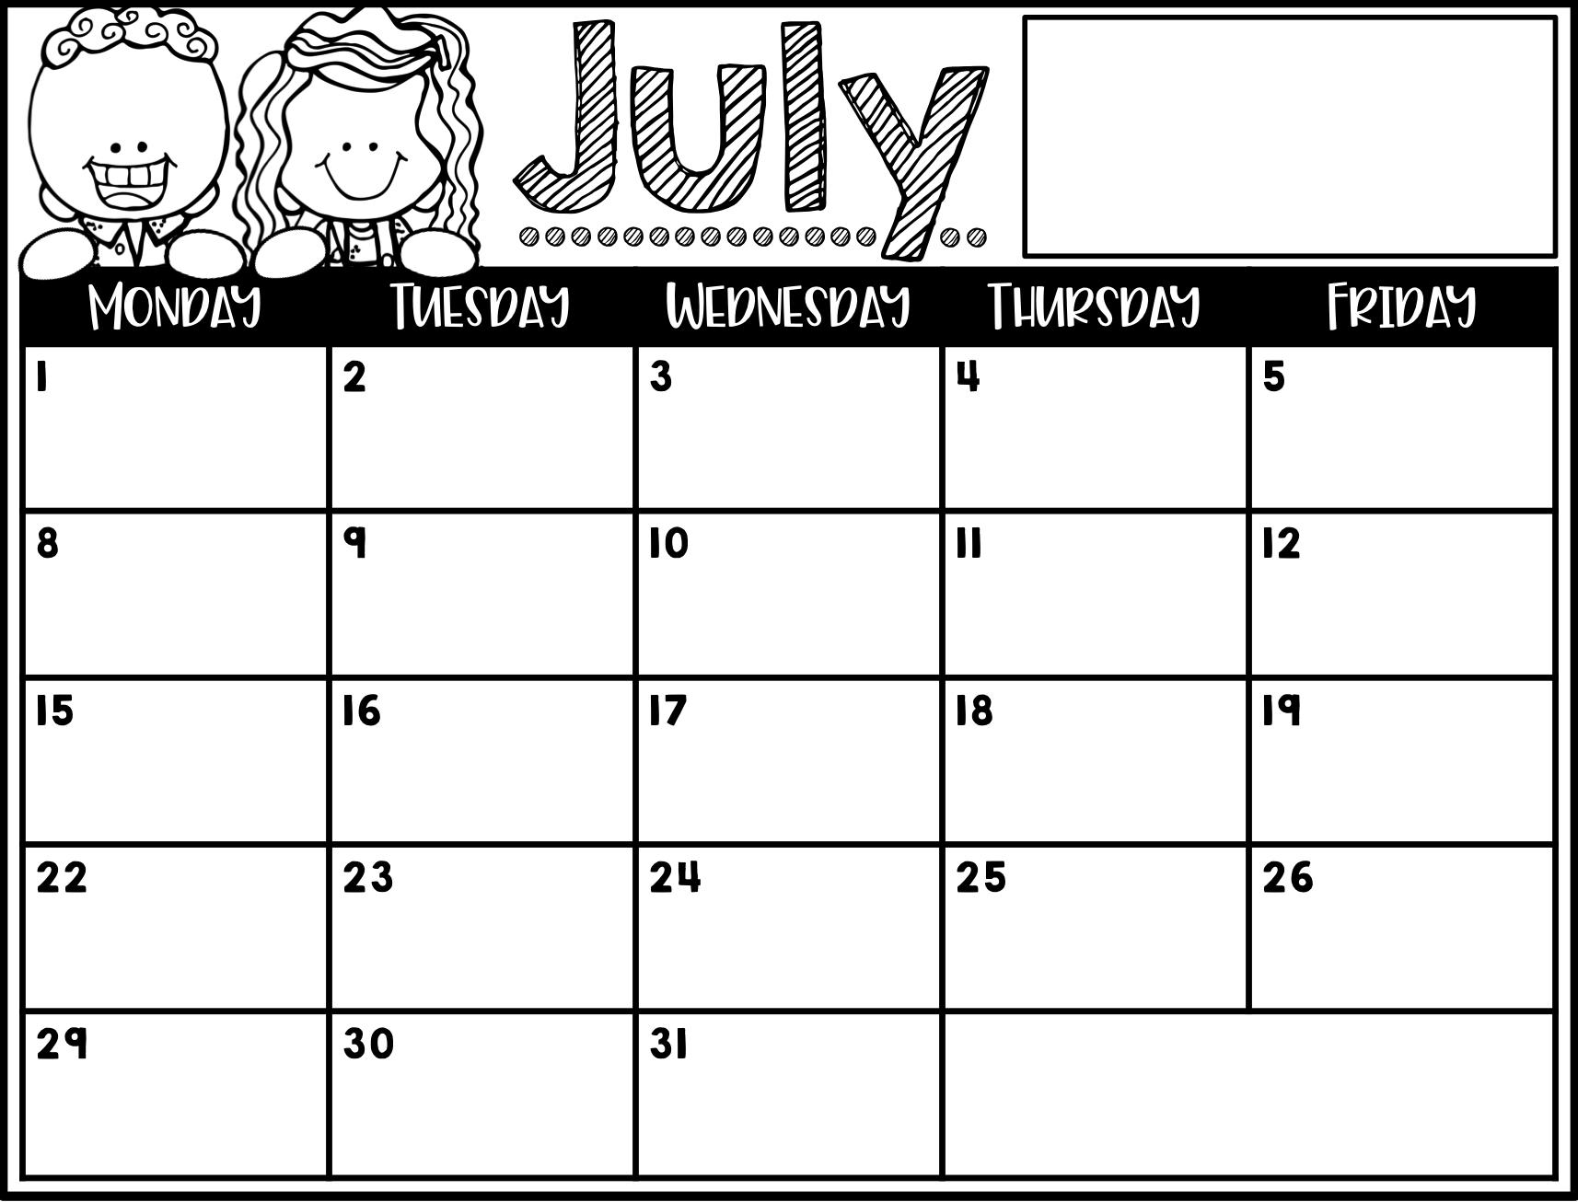
bcotherman@fusdaz.org
maspden@fusdaz.org
Third Grade
Meet the Teacher
First Day of School
Math & Spelling tests
Student Forms Due
type
Multiplication Fact test
Type Here
Type Here
Type Here
Multiplication Fact test
Refrigerator Copy

Slide 2
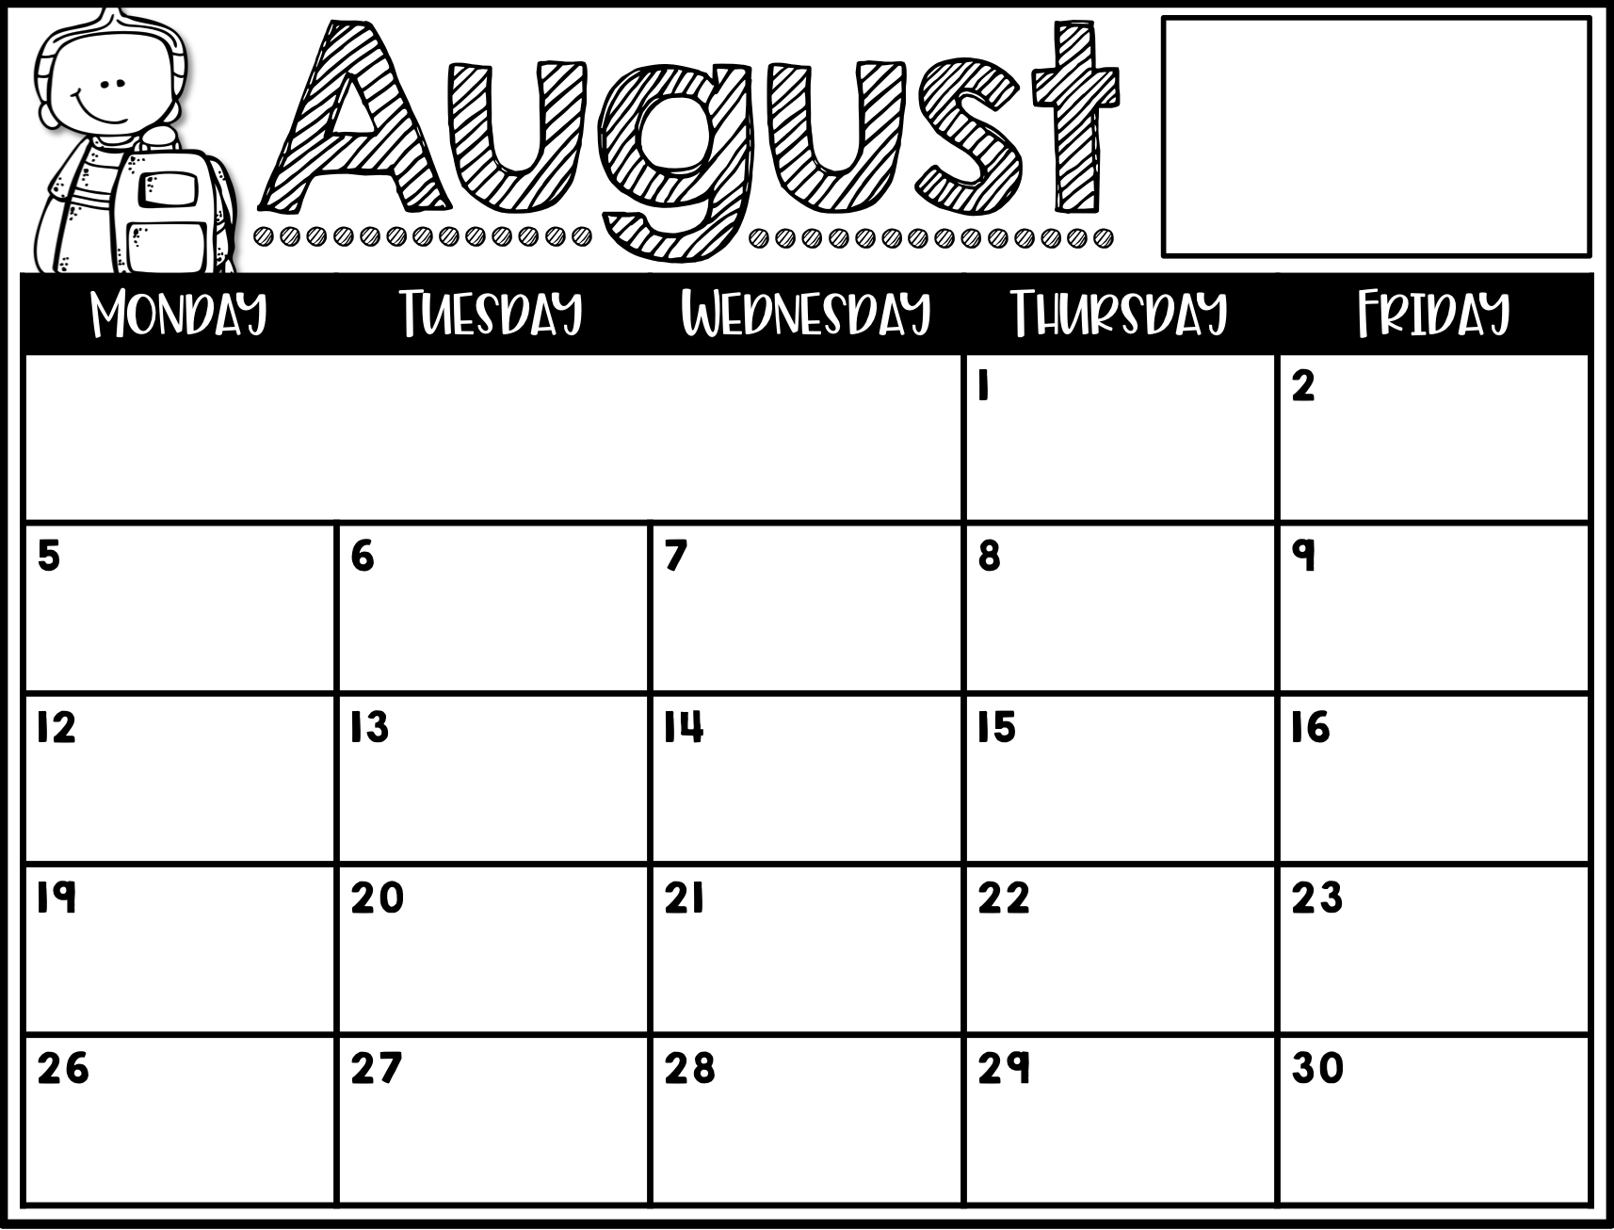
bcotherman@fusdaz.org
maspden@fusdaz.org
Third Grade
Refrigerator Copy
Type Here
Math & Spelling tests
Type Here
Type Here
Multiplication Fact test
Type Here
Math & Spelling tests
Type Here
Type Here
Multiplication Fact test
Type Here
Math & Spelling tests
Type Here
Type Here
Multiplication Fact test
Type Here
Math & Spelling tests
Type Here
Type Here
Multiplication Fact test
Type Here
Math & Spelling tests

Slide 3
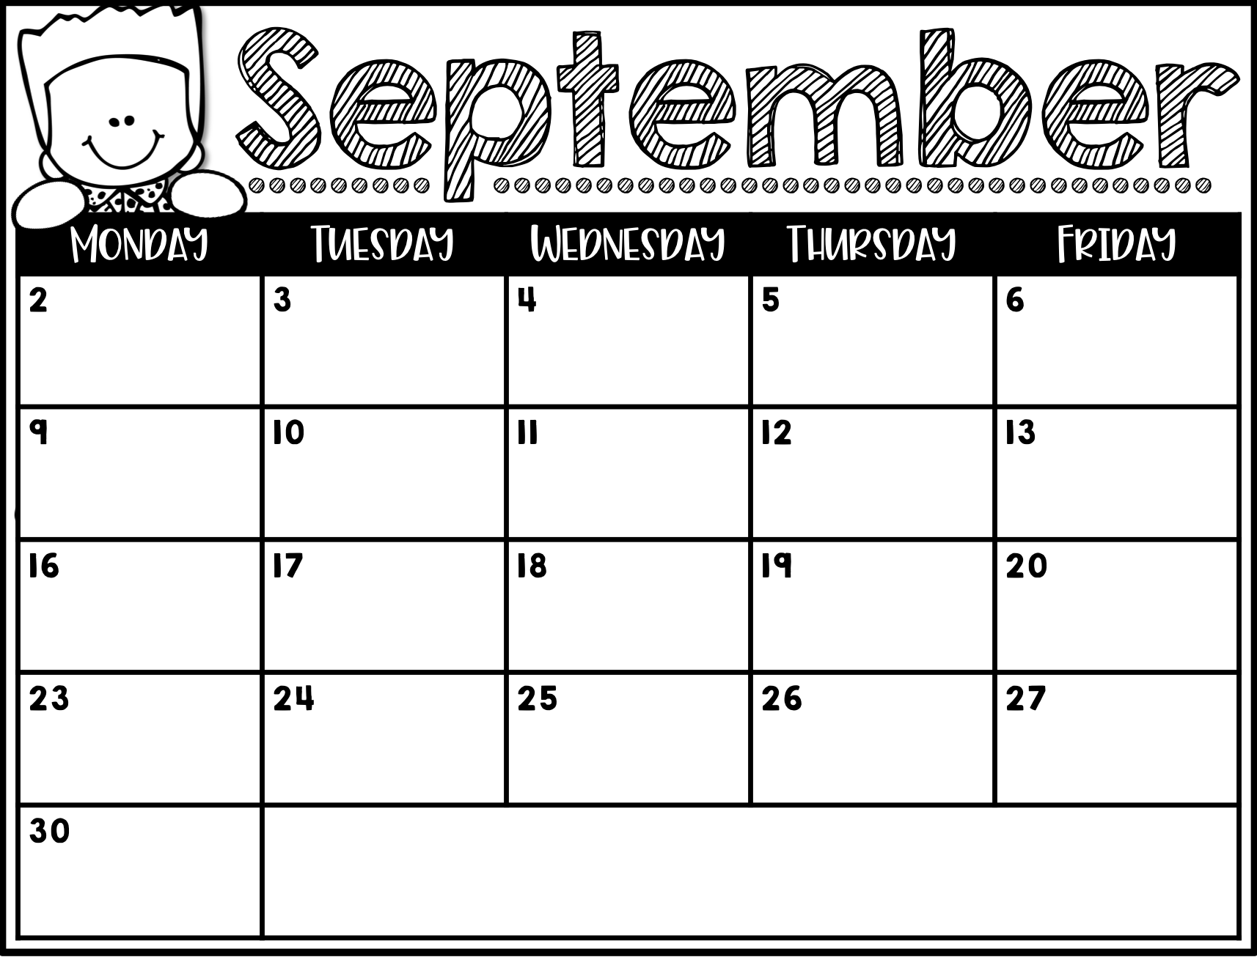
Labor Day
No School
Type Here
Multiplication Fact test
Type Here
Math & Spelling tests
Type Here
Type Here
Multiplication Fact test
Type Here
Math & Spelling tests
Math & Spelling tests
Early Release
Type Here
Type Here
Parent Teacher Conferences
Parent Teacher Conferences
Fall Break
Fall Break
Refrigerator Copy

Slide 4
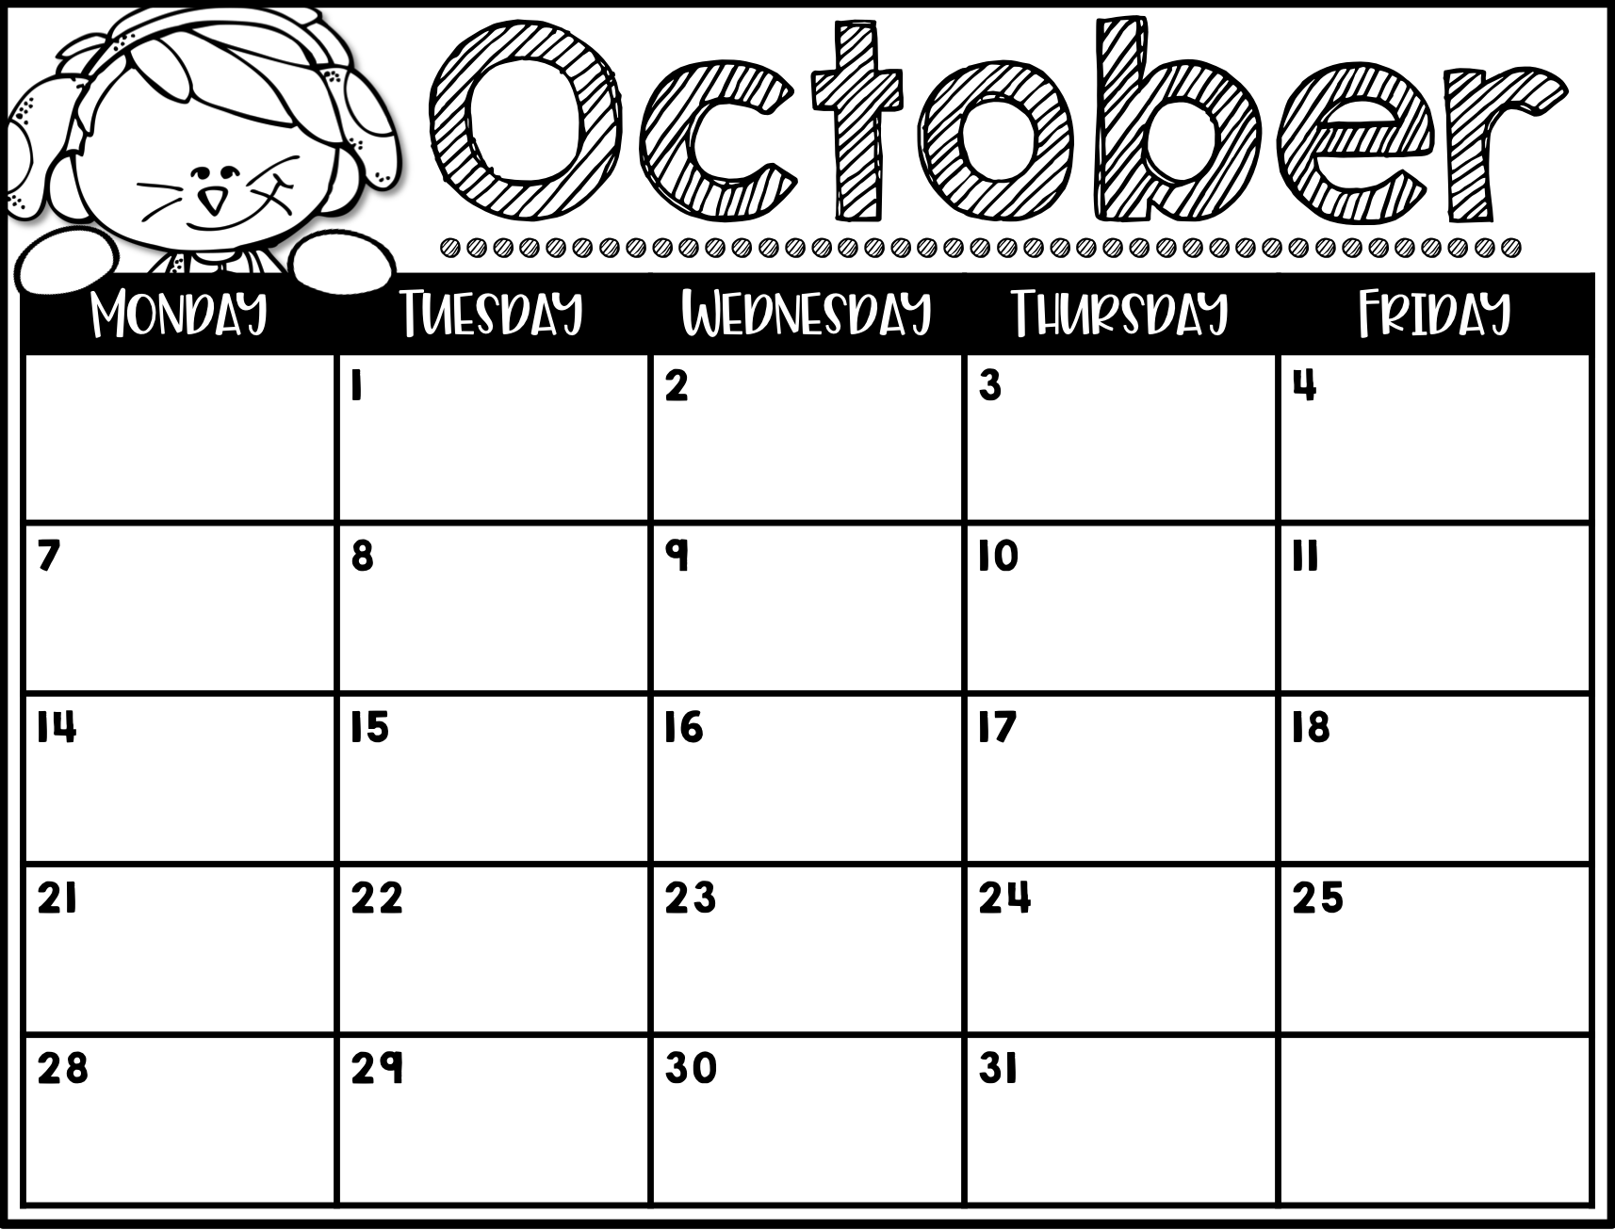
Type Here
Type Here
Multiplication Fact test
Type Here
Math & Spelling tests
Type Here
Type Here
Multiplication Fact test
Type Here
Math & Spelling tests
Type Here
Type Here
Multiplication Fact test
Type Here
Math & Spelling tests
Type Here
Type Here
Multiplication Fact test
Type Here
Math & Spelling tests

Slide 5
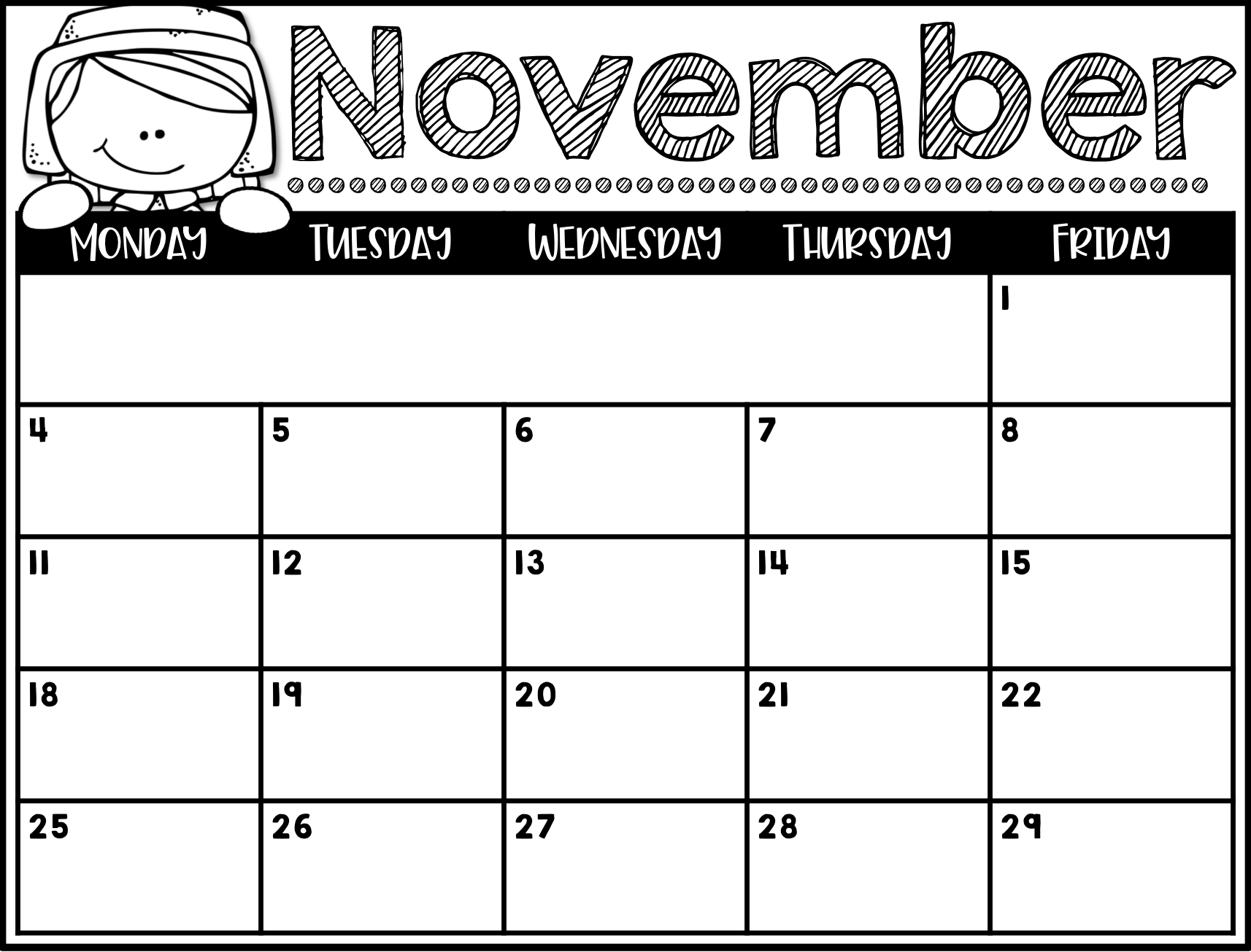
Refrigerator Copy
Math & Spelling tests
Type Here
Type Here
Multiplication Fact test
Type Here
Math & Spelling tests
Veteran’s Day
No School
Type Here
Multiplication Fact test
Type Here
Math & Spelling tests
Type Here
Type Here
Multiplication Fact test
Type Here
Math & Spelling tests
Type Here
Type Here
Thanksgiving Break

Slide 6
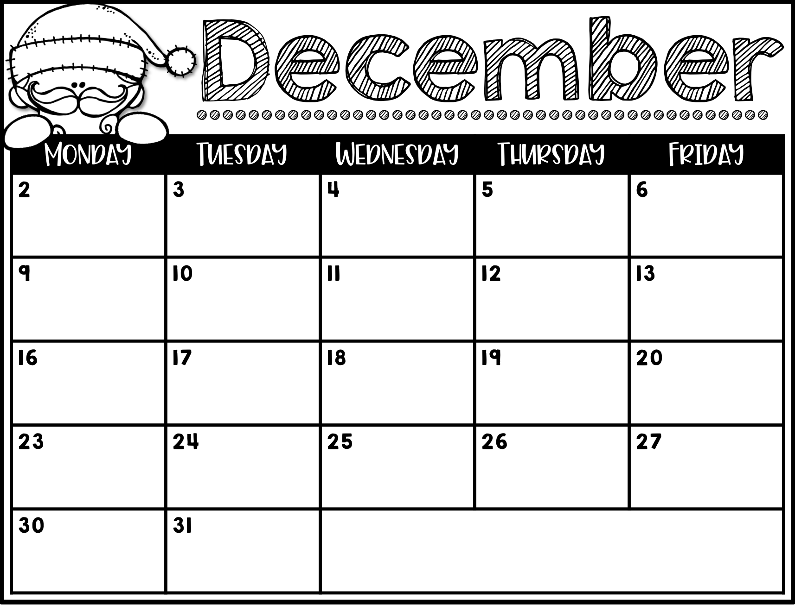
Type Here
Type Here
Multiplication Fact test
Type Here
Math & Spelling tests
Type Here
Type Here
Multiplication Fact test
Early Release
Math & Spelling tests
Early Release
Winter Break
Refrigerator Copy

Slide 7
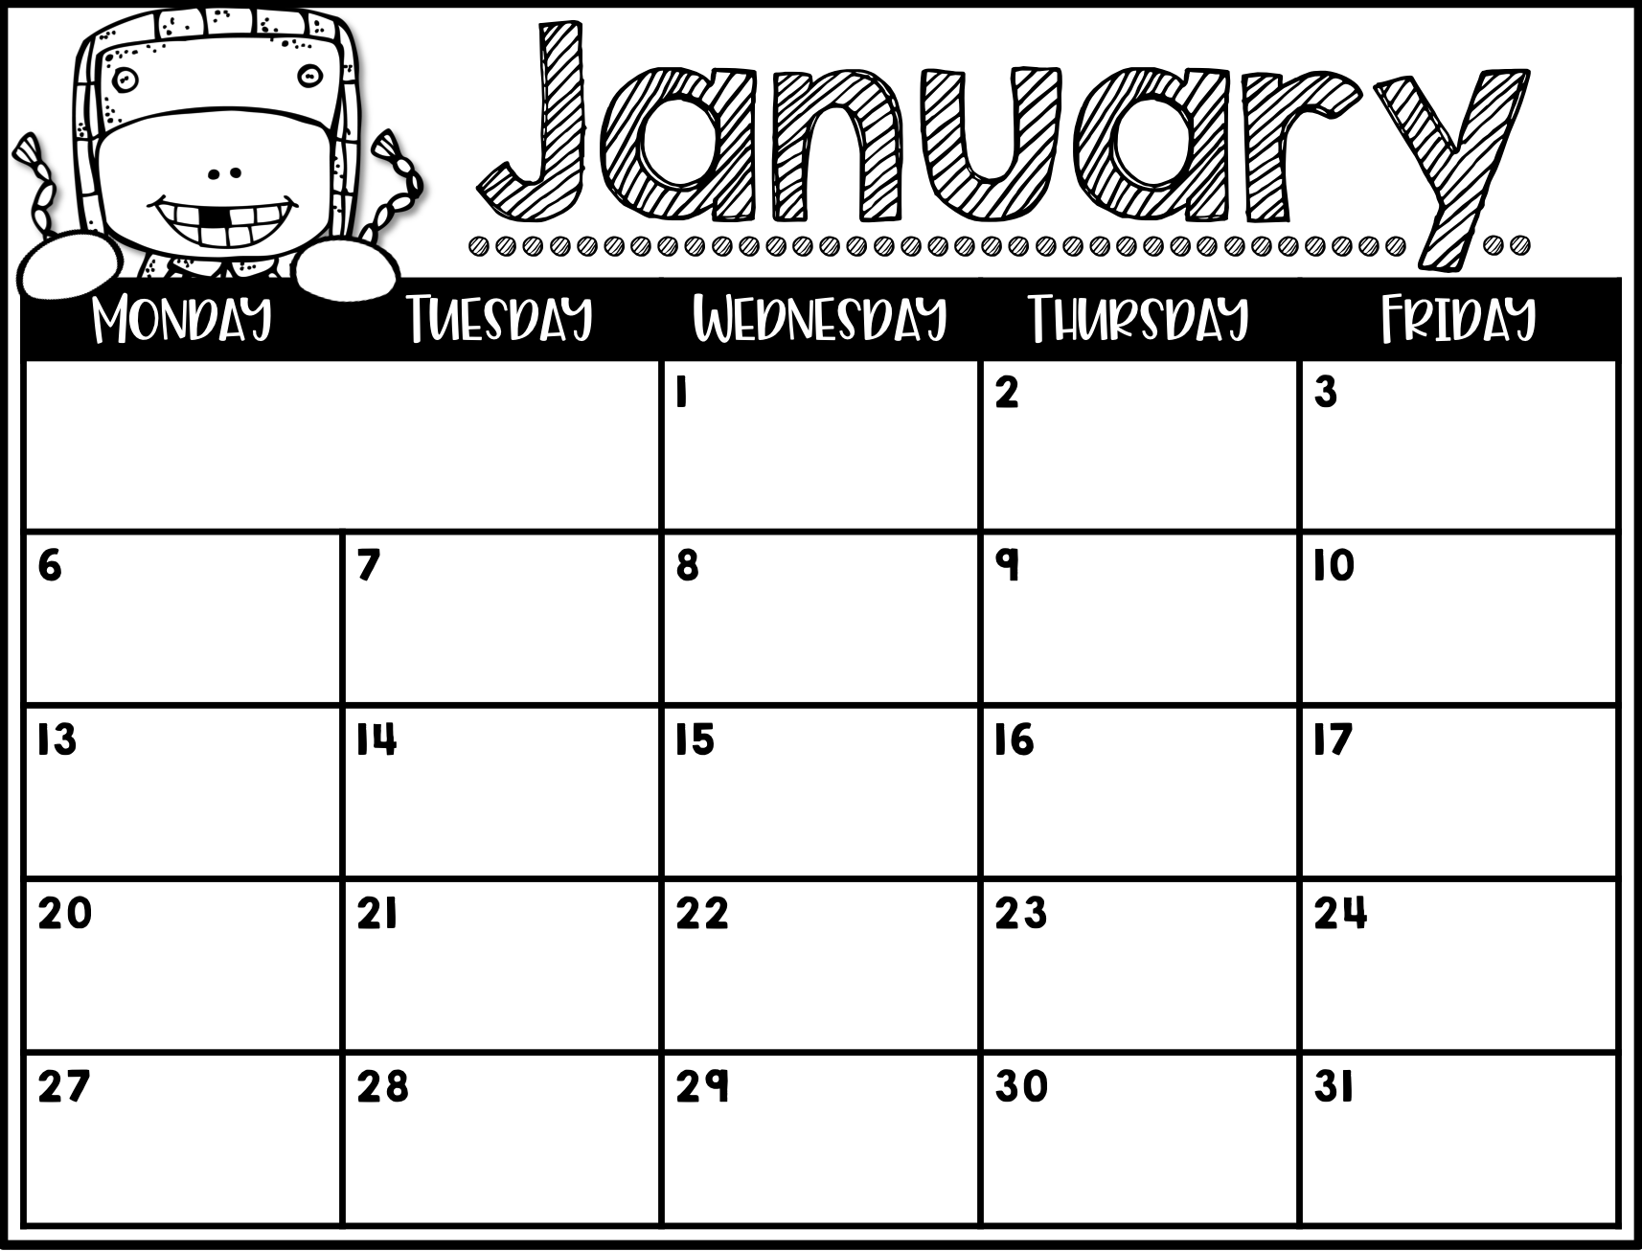
Refrigerator Copy
Winter Break
First Day Back to School
Type Here
Multiplication Fact test
Type Here
Math & Spelling tests
Type Here
Type Here
Multiplication Fact test
Type Here
Math & Spelling tests
MLK Jr Day
No School
Type Here
Multiplication Fact test
Type Here
Math & Spelling tests
Type Here
Type Here
Multiplication Fact test
Type Here
Math & Spelling tests

Slide 8
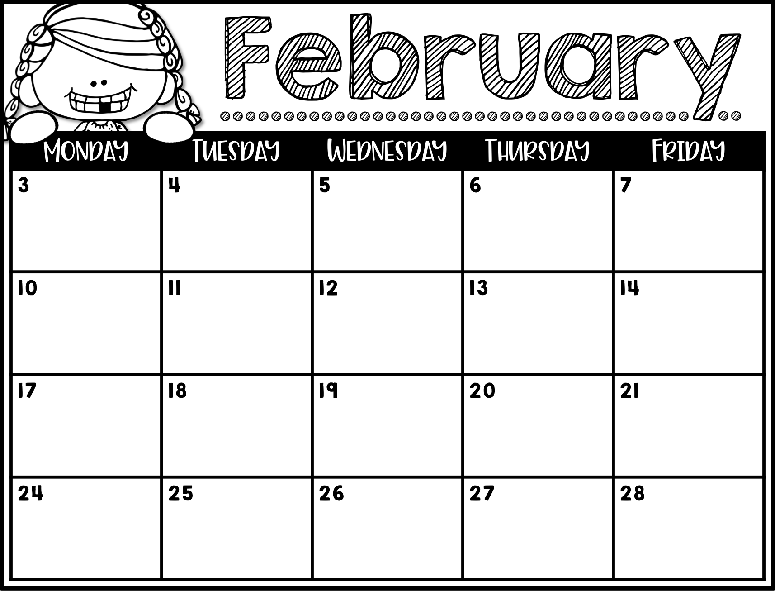
Multiplication Fact test
Parent Teacher Conferences
Math & Spelling tests
Early Release
Type Here
Type Here
Parent Teacher Conferences
Type Here
Type Here
Multiplication Fact test
Type Here
Math & Spelling tests
President’s Day
No School
Type Here
Multiplication Fact test
Type Here
Math & Spelling tests
Type Here
Type Here
Multiplication Fact test
Type Here
Math & Spelling tests

Slide 9
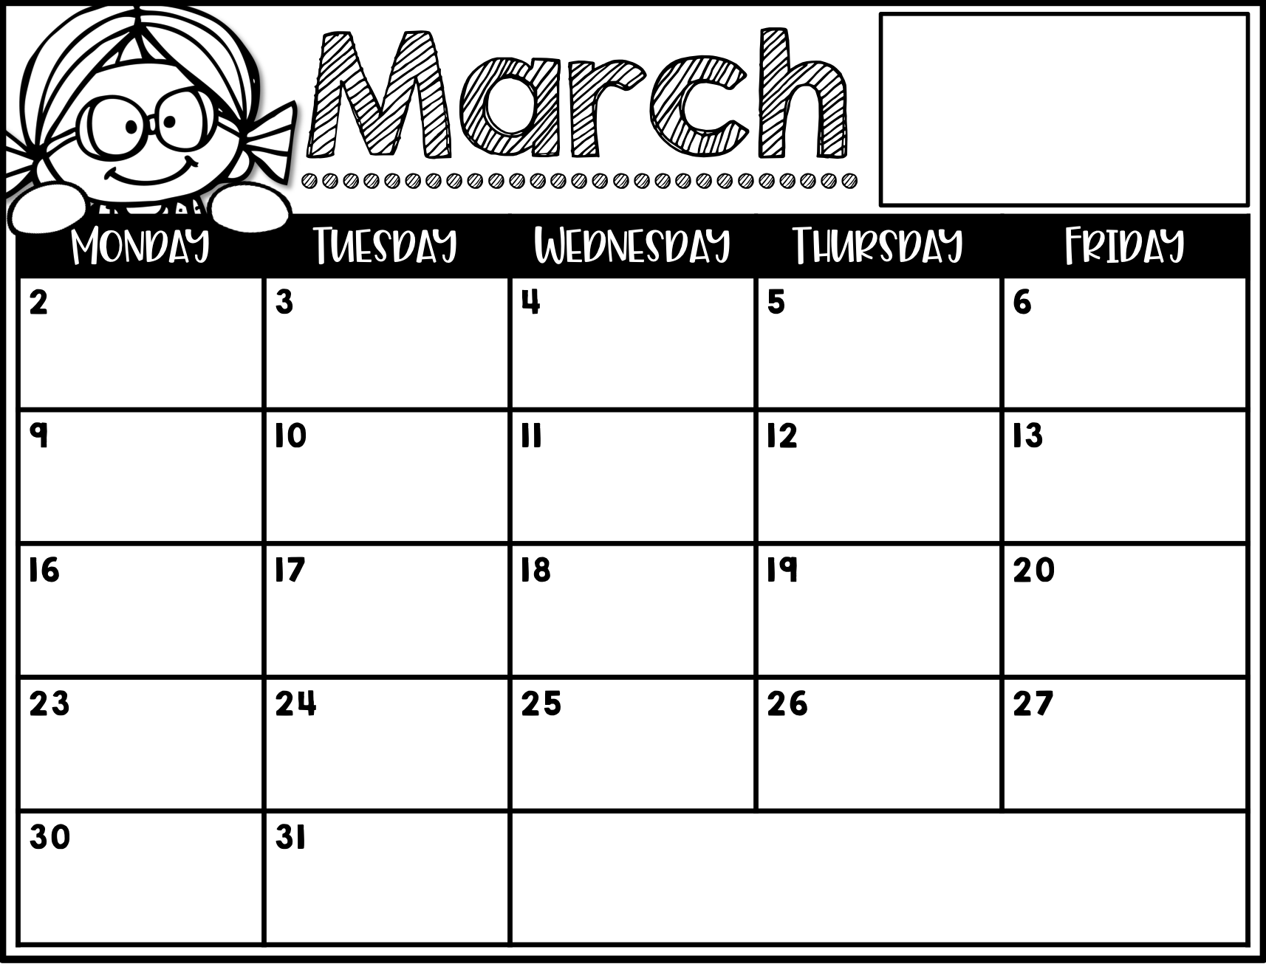
bcotherman@fusdaz.org
maspden@fusdaz.org
Third Grade
Type Here
Type Here
Multiplication Fact test
Type Here
Math & Spelling tests
Spring Break
Spring Break
Type Here
Type Here
Multiplication Fact test
Type Here
Math & Spelling tests
Type Here
Type Here
Refrigerator Copy

Slide 10
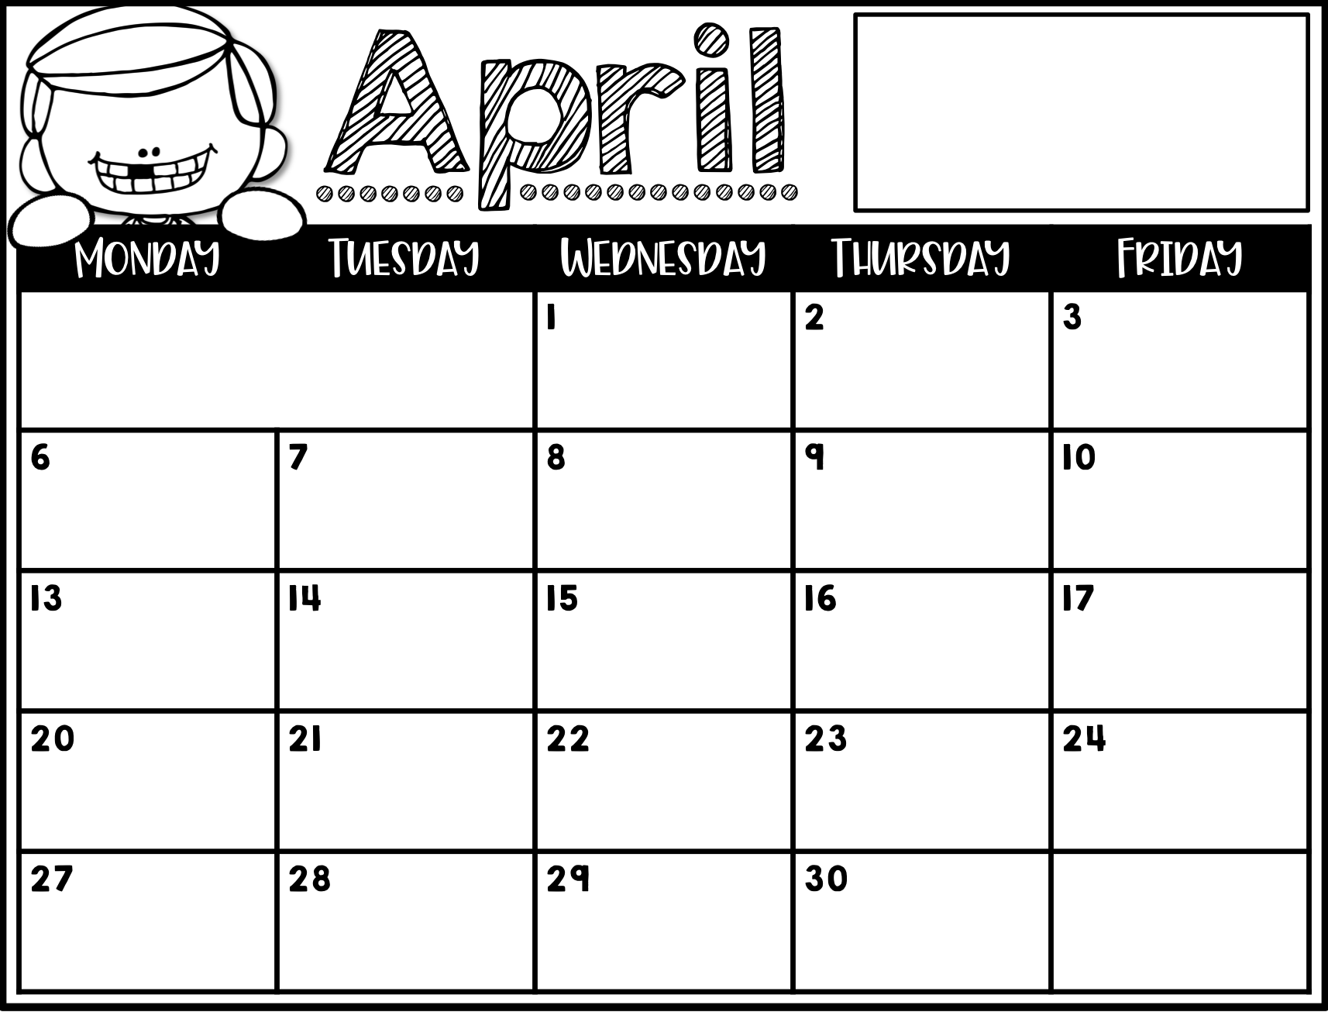
bcotherman@fusdaz.org
maspden@fusdaz.org
Third Grade
Refrigerator Copy
Multiplication Fact test
Type Here
Math & Spelling tests
Type Here
Type Here
Multiplication Fact test
Type Here
Math & Spelling tests
Type Here
Type Here
Multiplication Fact test
Type Here
Math & Spelling tests
Type Here
Type Here
Multiplication Fact test
Type Here
Math & Spelling tests
Type Here
Type Here
Multiplication Fact test
Type Here
Math & Spelling tests

Slide 11
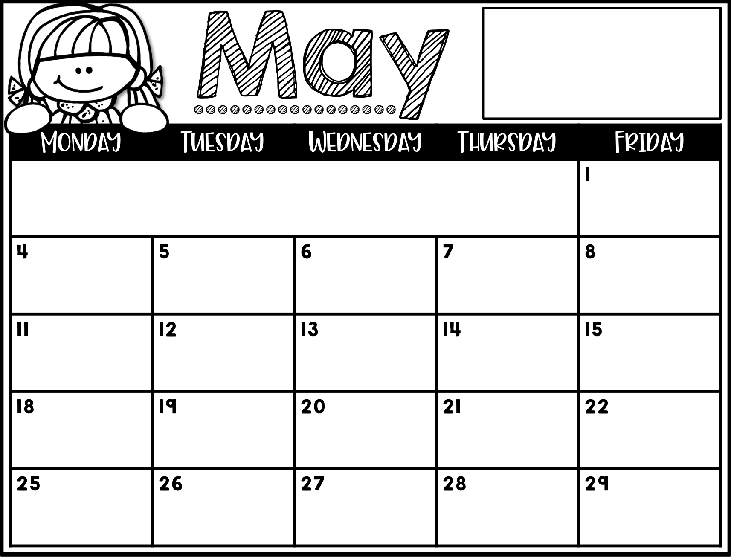
bcotherman@fusdaz.org
maspden@fusdaz.org
Third Grade
Refrigerator Copy
Math & Spelling tests
Type Here
Type Here
Multiplication Fact test
Type Here
Math & Spelling tests
Type Here
Type Here
Multiplication Fact test
Type Here
Math & Spelling tests
Last Day of School
Early Release
Type Here
Type Here
Early Release
No School
Memorial Day

