Slide 1
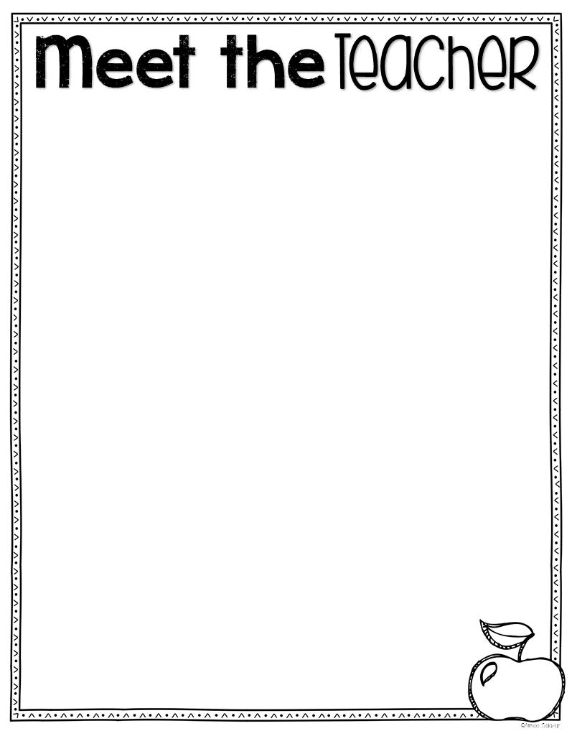
Dear Students and Families,
I am so happy to be your teacher this year! It’s going to be a fun year filled with learning and new experiences. I am really looking forward to getting to know you this year, and I just know we will have a blast learning and working together!
Before I get to know you, I would love for you to know a little bit about me. I grew up in a small town near Seattle, Washington. I obtained my Bachelor of Arts in Early Childhood Education and Elementary Education from Washington State University. I received my Masters in Education from Northern Arizona University. I have been teaching here at San Tan Heights for over 13 years!
I am married with two children and a pet chihuahua and turtle. My favorite colors are blue and green for the Seattle Seahawks. My favorite place is where ever my family is. We love traveling and exploring the world by cruising. I also enjoy cheering on our favorite sports teams. My favorite hobby is to cook. I love to try out new recipes.
I am looking forward to getting to know you. I hope
you’re ready to learn, and have some fun!
Sincerely,
Mrs. Aspden

